Slide 1
Male Starvation as an Expression of Psychological Turmoil:
The Tortured Cases of Midwinter and Heathcliff
Joanne Ella Parsons

Slide 2
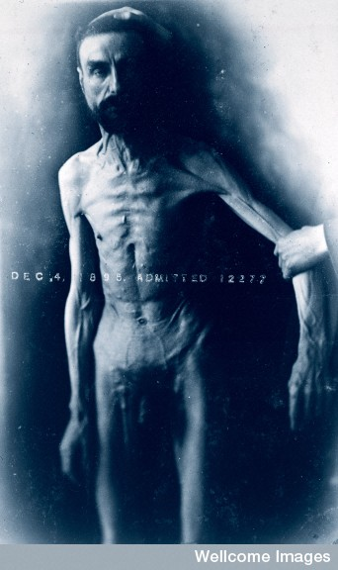
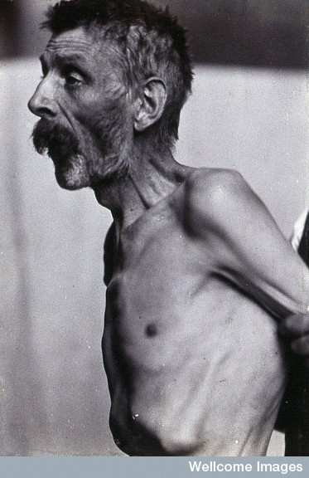

Slide 3
…drank nothing but water flavoured with a little orange-juice. He was seen by Dr. Willan on the sixty-first day of his fast. At that time he was emaciated to a most astonishing degree; the muscles of his face were entirely shrunk, his cheek bones stood prominent and distinct, affording a most ghastly appearance; the abdomen was concave from the collapsed state of his intestines, the limbs were reduced to the greatest possible degree of tenuity, and the processes of their bones were easily distinguishable. His whole appearance suggested the idea of a skeleton prepared by drying the muscles upon it in their natural situations. His mind had become imbecile.
(Winslow 261)

Slide 4
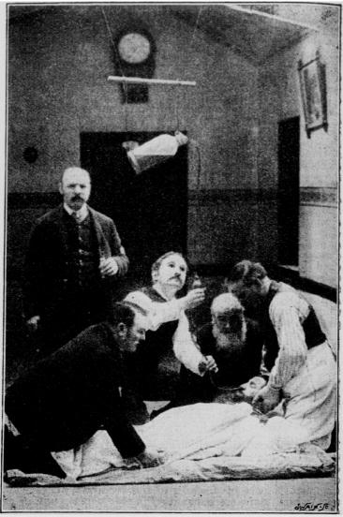
among insane patients, refusal to take bodily nourishment is a common occurrence, and has to be met with prompt adoption of coercive measures. All disorders of the nervous system, and particularly those implicating the intelligence, have a damaging influence upon the functions of nutrition. In cases of simple anxiety of mind, how often do we observe the general health to become seriously impaired, and the assimilative powers to become completely paralysed! In the incipient stages of insanity the nutritive functions appear occasionally altogether suspended. The patient, long before attention is called to the state of mind, loses flesh, and is occasionally reduced to a dangerous state of emaciation and inanition.
(Winslow 274)

Slide 5
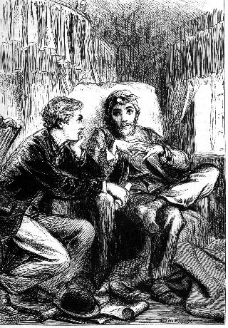
Ozias Midwinter, recovering from brain fever, was a startling object to contemplate...

Slide 6
One of them sat at the well-spread table, hungry and happy; ranging from dish to dish, and declaring that he had never made such a breakfast in his life. The other sat apart at the window; his cup thanklessly deserted before it was empty, his meat left ungraciously half-eaten on his plate
(Collins 139)

Slide 7
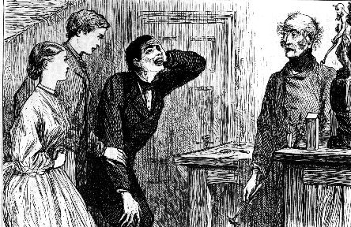
…the fever of Midwinter’s false spirits flamed out into sheer delirium as the performance of the puppets came to an end. His paroxysms of laughter followed each other with such convulsive violence, that Miss Milroy started back from him in alarm, and even the patient major turned on him with a look which said plainly, Leave the room!’ (Collins 225)

Slide 8
He talked, and laughed, and heaped his plate indiscriminately from every dish on the breakfast table. He made noisily merry with jests that had no humour, and stories that had no point... He shouted with laughter over the sudden development of Allan’s view on marriage, until the servants downstairs began to think that their master’s strange friend had gone mad.
(Collins 221)

Slide 9
“I do love him! It will come out of me—I can’t keep it back. I love the very ground he treads on! I would give my life—yes the life that is precious to me now, because his kindness has made it a happy one—I tell you I would give my life—!”
(Collins 102)

Slide 10
Photographs reproduced with the kind permission of the Wellcome Library, London.

