Slide 1
Peering Outside the Silo: Portrayals of Mental Disorders and the Education of Healthcare Professionals
David H. Flood, PhD
Drexel University
Philadelphia, PA, USA

Slide 2
Literature and Madness
Literature Course
Literature “about” madness
Healthcare Course
Madness through literature
Mental disorders as seen through literature; analyzed using literary theories, concepts

Slide 3
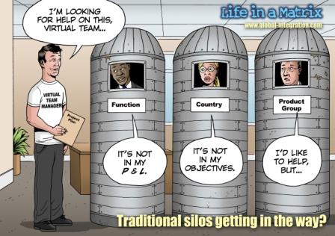
from www.global-integration.com

Slide 4
The instructor
--My evolution towards
medical humanities
The students
--Health sciences context
The course
--Specific examples of application

Slide 5
The Students
What do they need?
What do they want?
How can my course help?

Slide 6
Relevance
Patient/client communication
Professional and personal self
Problem solving
Empathy (stories vs. labels)

Slide 7
Tools of literary analysis
Macro level—narrative structure, plot, theme
  narrative theory: coherence
  narrative deconstruction
narrative therapy
narrative psychology

Slide 8
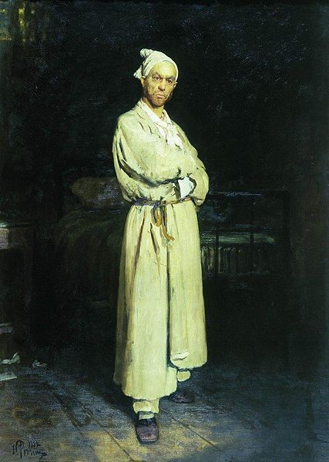
Gogol, “The Diary of a Madman” (1835)
Ilya Repin, Poprishchin [Gogol’s madman] (1882)

Slide 10
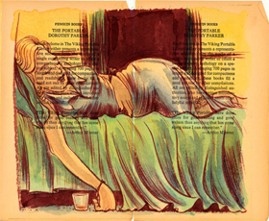
Parker, “Big Blonde” (1929)
From The Portable Dorothy Parker

Slide 11
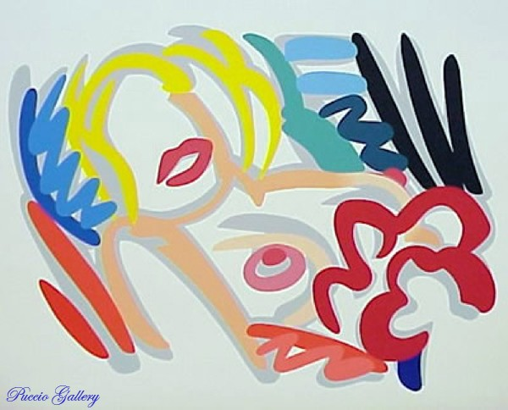
Tom Wesselmann, Big Blonde, 1989

Slide 12
Deconstruction
Cognitive therapy
Narrative therapy
Narrative psychology

Slide 13
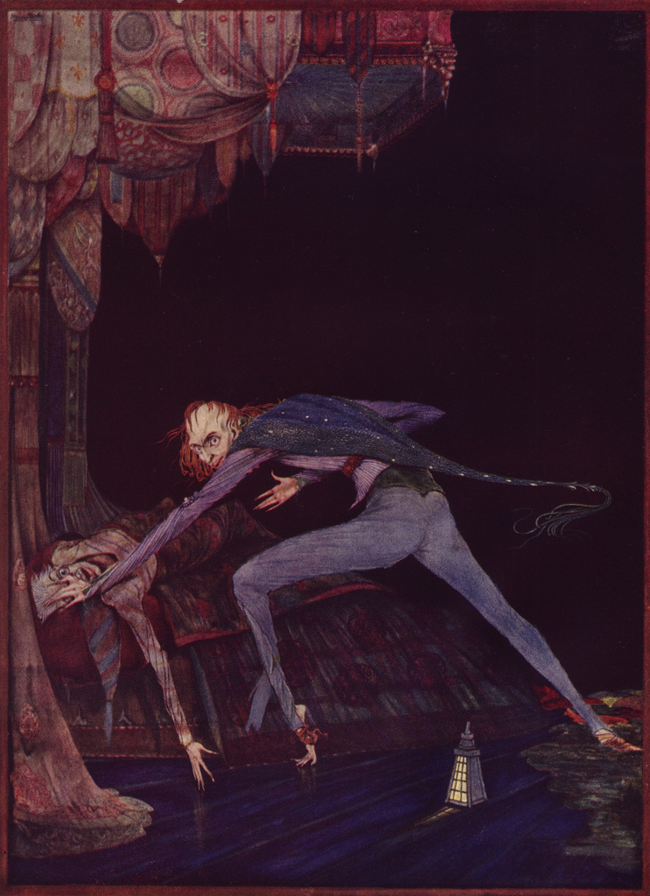
Micro/Elemental Level
Metaphor
Symbol
Word choice
Tone
Details
Harry Clarke, “The Tell-Tale Heart” illustration, 1919

Slide 14
Deconstruction
Cognitive therapy
Narrative therapy
Narrative psychology
Dissonance
Intentional fallacy

Slide 15
Reader Response Criticism
The Elephant Man
The Scream
Patient as text

Slide 16

Gil Lesser, cover for play (1979)

Slide 17
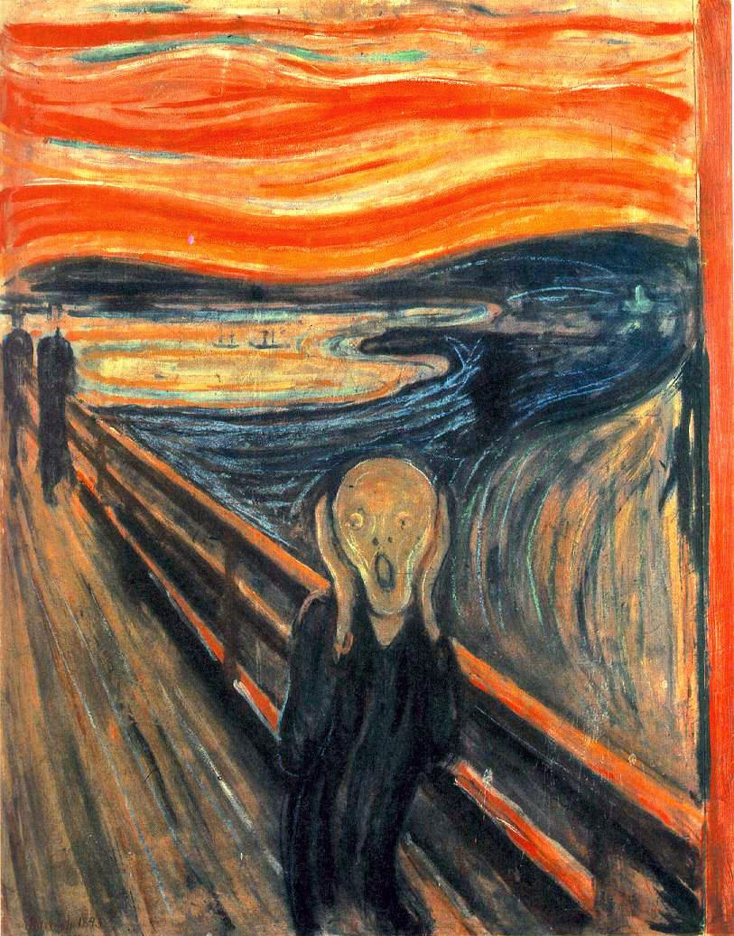
Edvard Munch, The Scream (1893)

Slide 18
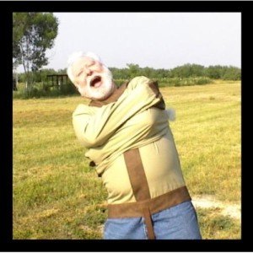
Theme song for Madness and Literature
(Napoleon XIV: “They’re Coming to Take Me Away,” 1966)
newmradio.wordpress.com

